Slide 1
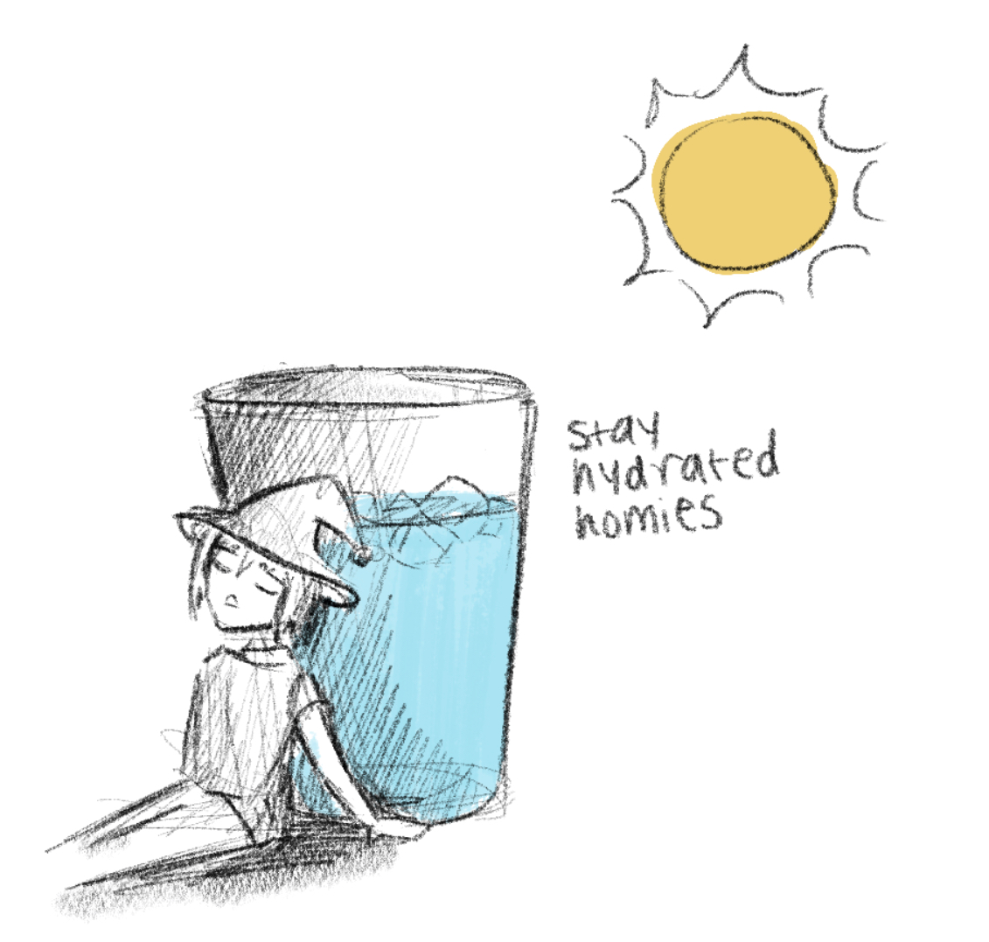
Certificates, Password Hashing, and Case Studies
CSE 405 Fall 2023
Lecture 8

Slide 2
Last Time: Public-Key Encryption and Digital Signatures
Public-key cryptography: Two keys; one undoes the other
Public-key encryption: One key encrypts, the other decrypts
Security properties similar to symmetric encryption
ElGamal: Based on Diffie-Hellman
The public key is g^{b}, and C1 is g^{r}.
Not IND-CPA secure on its own
RSA: Produce a pair e and d such that M^{ed} = M mod N
Not IND-CPA secure on its own
Hybrid encryption: Encrypt a symmetric key, and use the symmetric key to encrypt the message
Digital signatures: Integrity and authenticity for asymmetric schemes
RSA: Same as RSA encryption, but encrypt the hash with the private key

Slide 3
Today
Certificates: How do we distribute public keys securely?
Password Hashing: How do we securely store passwords?
Case studies
How can we discover bad cryptography?
How do we securely send messages in practice?
How can we report abusive behavior?

Slide 4
Certificates
Textbook Chapter 13

Slide 5
Review: Public-Key Cryptography
Public-key cryptography is great! We can communicate securely without a shared secret
Public-key encryption: Everybody encrypts with the public key, but only the owner of the private key can decrypt
Digital signatures: Only the owner of the private key can sign, but everybody can verify with the public key
What’s the catch?

Slide 6
Problem: Distributing Public Keys
Public-key cryptography alone is not secure against man-in-the-middle attacks
Scenario
Alice wants to send a message to Bob
Alice asks Bob for his public key
Bob sends his public key to Alice
Alice encrypts her message with Bob’s public key and sends it to Bob
What can Mallory do?
Replace Bob's public key with Mallory’s public key
Now Alice has encrypted the message with Mallory’s public key, and Mallory can read it!

Slide 7
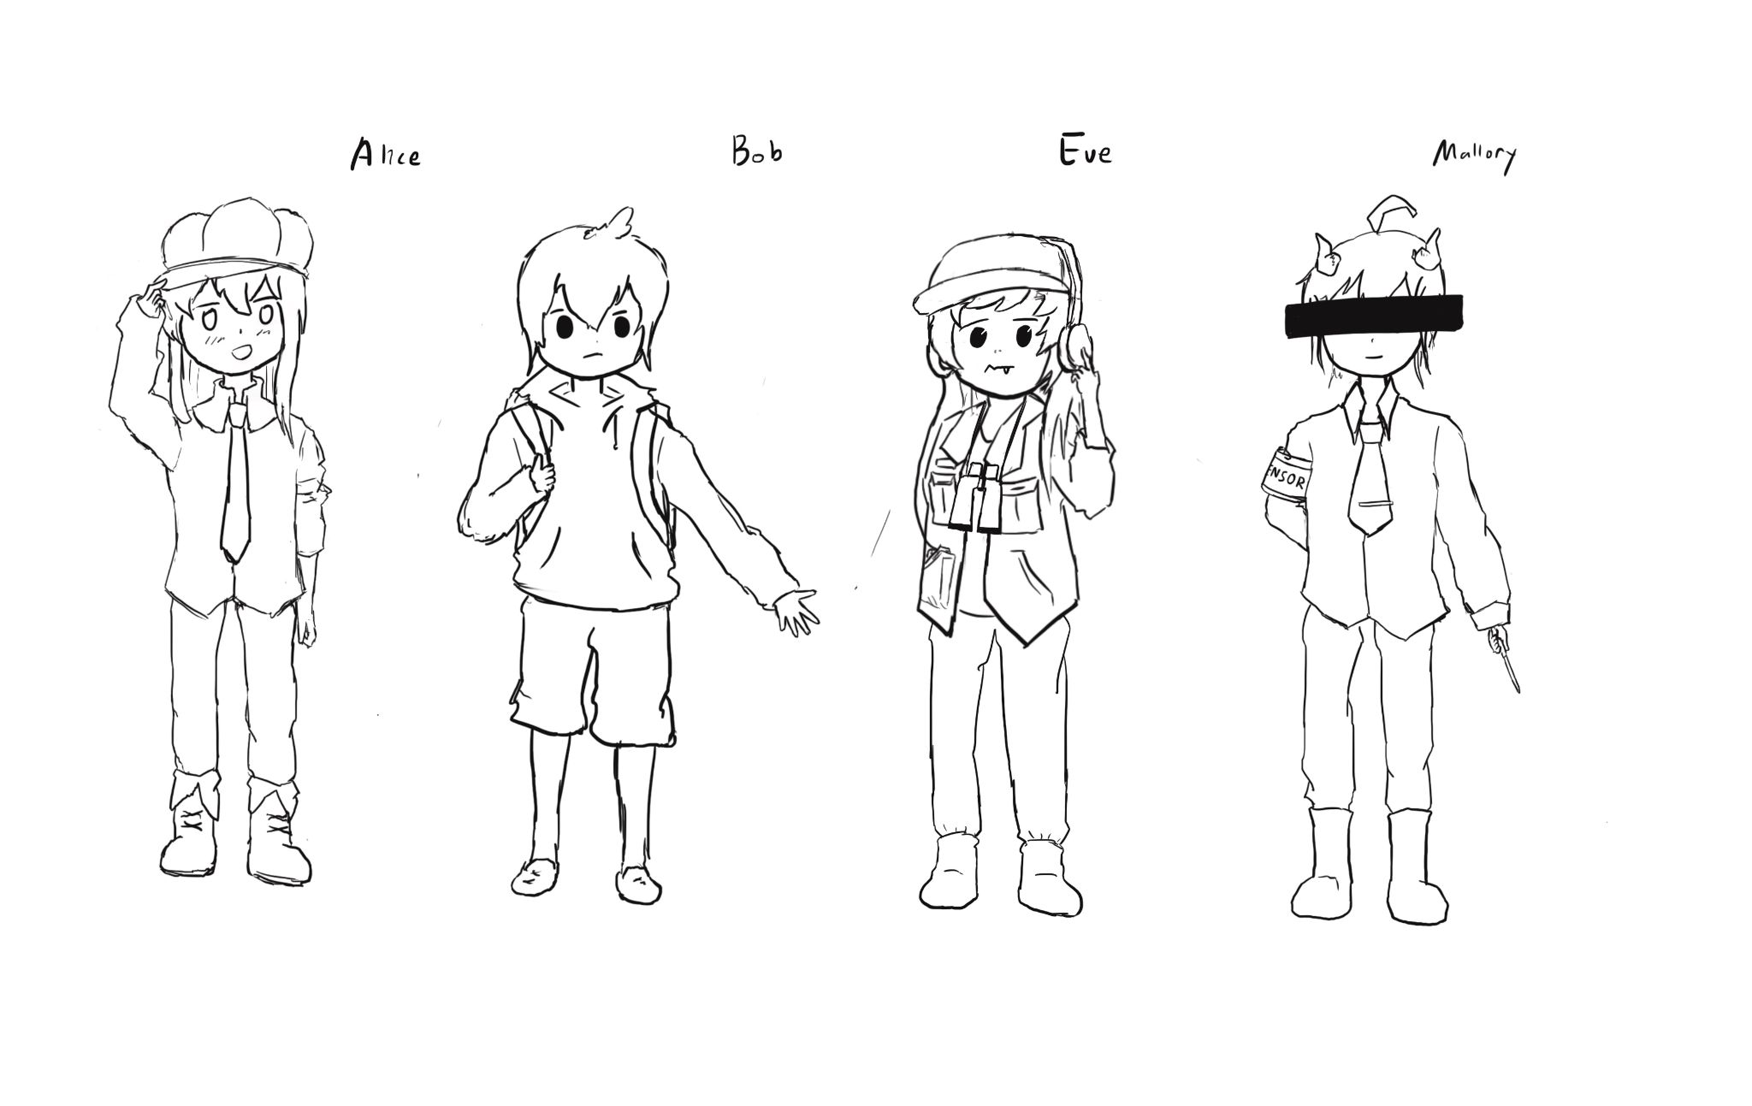
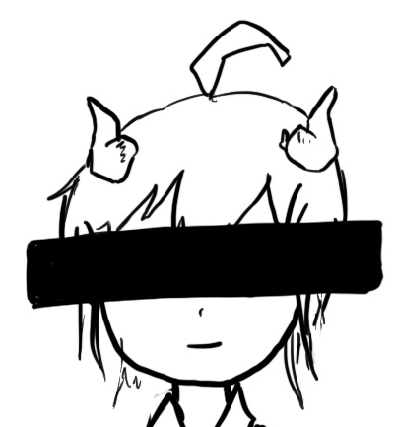
Problem: Distributing Public Keys
Alice
Mallory
Bob
Generate PKB, SKB
Send PKB
Send PKM
Receive PKM
Send {M}PKM
Decrypt {M}PKM
Send {M}PKB
Decrypt {M}PKB

Slide 8
Problem: Distributing Public Keys
Idea: Sign Bob’s public key to prevent tampering
Problem
If Bob signs his public key, we need his public key to verify the signature
But Bob’s public key is what we were trying to verify in the first place!
Circular problem: Alice can never trust any public key she receives
You cannot gain trust if you trust nothing. You need a root of trust!
Trust anchor: Someone that we implicitly trust
From our trust anchor, we can begin to trust others

Slide 9
Trust-on-First-Use
Trust-on-first-use: The first time you communicate, trust the public key that is used and warn the user if it changes in the future
Used in SSH and a couple other protocols
Idea: Attacks aren’t frequent, so assume that you aren’t being attacked the first time communicate
Also known as “Leap of Faith”

Slide 10
Certificates
Certificate: A signed endorsement of someone’s public key
A certificate contains at least two things: The identity of the person, and the key
Abbreviated notation
Encryption under a public key PK: {“Message”}PK
Signing with a private key SK: {“Message”}SK⁻¹
Recall: A signed message must contain the message along with the signature; you can’t send the signature by itself!
Scenario: Alice wants Bob’s public key. Alice trusts EvanBot (PKE, SKE)
EvanBot is our trust anchor
If we trust PKE, a certificate we would trust is {“Bob’s public key is PKB”}SKE⁻¹
Notes:
Ask: Why not just Sign

Slide 11
Attempt #1: The Trusted Directory
Idea: Make a central, trusted directory (TD) from where you can fetch anybody’s public key
The TD has a public/private keypair PKTD, SKTD
The directory publishes PKTD so that everyone knows it (baked into computers, phones, OS, etc.)
When you request Bob’s public key, the directory sends a certificate for Bob’s public key
{“Bob’s public key is PKB”}SKTD⁻¹
If you trust the directory, then now you trust every public key from the directory
What do we have to trust?
We have received TD’s key correctly
TD won’t sign a key without verifying the identity of the owner
Notes:
Ask at the end of the slide: What are some problems with this?

Slide 12
Attempt #1: The Trusted Directory
Let’s say that Michael Drake (MD, President of UC) runs the TD
We want Nick Weaver’s public key: Ask MD
We want David Wagner’s public key: Ask MD
We want Raluca Ada Popa’s public key: Ask MD
MD has better things to do (like making sure his private key isn’t stolen)!
Problems: Scalability
One directory won’t have enough compute power to serve the entire world
Problem: Single point of failure
If the directory fails, cryptography stops working
If the directory is compromised, you can’t trust anyone
If the directory is compromised, it is difficult to recover

Slide 13
Certificate Authorities
Addressing scalability: Hierarchical trust
The roots of trust may delegate trust and signing power to other authorities
{“Carol Christ’s public key is PKCC, and I trust her to sign for UCB”}SKMD⁻¹
{“Dave Wagner’s public key is PKDW, and I trust him to sign for the CS department”}SKCC⁻¹
{“Nick Weaver’s public key is PKNW (but I don’t trust him to sign for anyone else)”}SKDW⁻¹
MD is still the root of trust (root certificate authority, or root CA)
CC and DW receive delegated trust (intermediate CAs)
NW’s identity can be trusted
Addressing scalability: Multiple trust anchors
There are ~150 root CAs who are implicitly trusted by most devices
Public keys are hard-coded into operating systems and devices
Each delegation step can restrict the scope of a certificate’s validity
Creating the certificates is an offline task: The certificate is created once in advance, and then served to users when requested

Slide 14
Revocation
What happens if a certificate authority messes up and issues a bad certificate?
Example: {“Bob’s public key is PKM”}SKCA⁻¹
Example: Verisign (a certificate authority) accidentally issued a certificate saying that an average Internet user’s public key belonged to Microsoft

Slide 15
Revocation: Expiration Dates
Approach #1: Each certificate has an expiration date
When the certificate expires, request a new certificate from the certificate authority
The bad certificate will eventually become invalid once it expires
Benefits
Mitigates damage: Eventually, the bad certificate will become harmless
Drawbacks
Adds management burden: Everybody has to renew their certificates frequently
If someone forgets to renew a certificate, their website might stop working
Tradeoff: How often should certificates be renewed?
Frequent renewal: More secure, less usable
Infrequent renewal: Less secure, more usable
LetsEncrypt (a certificate authority) chose very frequent renewal
It turns out frequent renewal is more usable: It forces automated renewal instead of a once-every 3 year task that gets forgotten!

Slide 16
Revocation: Announcing Revoked Certificates
Approach #2: Periodically release a list of invalidated certificates
Users must periodically download a Certification Revocation List (CRL)
How do we authenticate the list?
The certificate authority signs the list!
{“The certificate with serial number 0xdeadbeef is now revoked”}SKCA⁻¹
Drawbacks
Lists can get large
Mitigated by shorter expiration dates (don’t have to list them once they expire)
Until a user downloads a list, they won’t know which certificates are revoked
What happens if the certificate authority is unavailable?
Fail-safe default: Assume all certificates are invalid? Now we can’t trust anybody!
Possible attack: Attacker forces the CA to be unavailable (denial of service attack)
Use old list: Potentially dangerous if the old list is missing newly revoked certificates

Slide 17
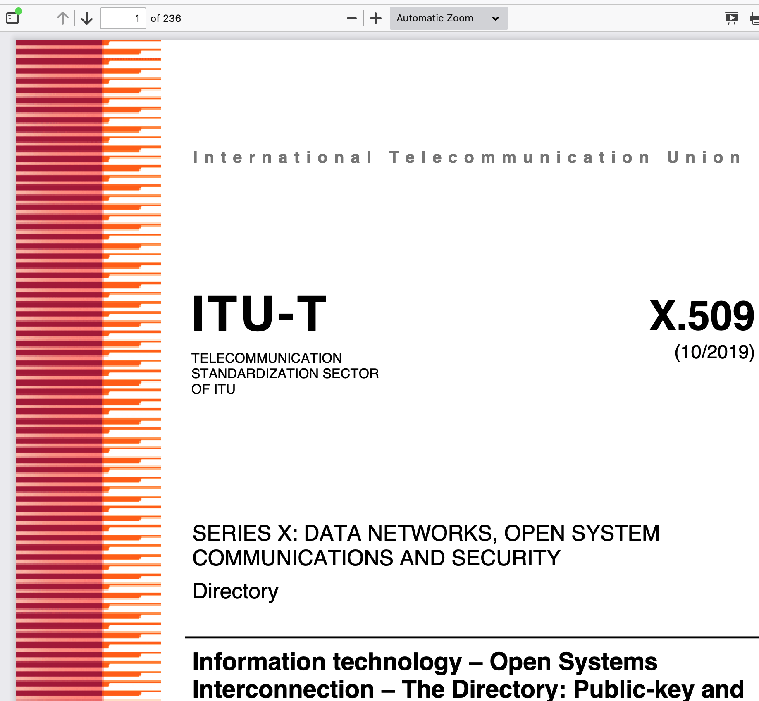
Certificates: Complexity
Certificate protocols can get very complicated
Example: X.509 is incredibly complicated (a 236 page standard!) because it tried to do everything
Notes:
https://tools.ietf.org/html/rfc5280

Slide 18
Alternative: Web of Trust
Modern public-key infrastructures are structured like trees
Originally, public-key infrastructures looked like graphs instead
Everybody can issue certificates for anyone else
Example: Alice signs Bob’s key. Bob signs Carol’s key. If Dave trusts Alice, he trusts Bob and Carol.
Benefit: You know the trust anchor personally (e.g. because you met them in-person, or because you signed their key)
Problem: Graphs get far more complex than trees!
OpenPGP (Pretty Good Privacy) originally used the web of trust model
Key-signing parties: meeting in-person to sign each other’s public keys
It quickly proved to be a disaster
Instead, everyone just relies on MIT’s central keyserver which is broken!
Takeaway: Trust anchors make public-key infrastructures much simpler!

Slide 19
Summary: Certificates
Certificates: A signed attestation of identity
Trusted directory: One server holds all the keys, and everyone has the TD’s public key
Not scalable: Doesn’t work for billions of keys
Single point of failure: If the TD is hacked or is down, cryptography is broken
Certificate authorities: Delegated trust from a pool of multiple root CAs
Root CAs can sign certificates for intermediate CAs
Revocation: Certificates contain an expiration date
Revocation: CAs sign a list of revoked certificates

Slide 20
Password Hashing
Textbook Chapter 14

Slide 21
Review: Cryptographic Hashes
Hashes accept arbitrarily large inputs
Hashes “look” random
Change a single bit on the input and each output bit has a 50% chance of flipping
And until you change the input, you can't predict which output bits are going to change
The ones we talked about are fast
Can operate at many many MB/s: Faster at processing data than block ciphers
Recall: Security properties
One way: Given an output y, it is infeasible to find any input x such that H(x) = y.
Collision resistant: It is infeasible to find another any pair of inputs x' ≠ x such that H(x) = H(x').

Slide 22
Storing Passwords
Password: A secret string a user types in to prove their identity
When you create an account with a service: Create a password
When you later want to log in to the service: Type in the same password again
How does the service check that your password is correct?
Bad idea #1: Store a file listing every user’s password
Problem: What if an attacker hacks into the service? Now the attacker knows everyone’s passwords!
Bad idea #2: Encrypt every user’s password before storing it
Problem: The attacker could steal the passwords file and the key and decrypt everyone’s passwords!
We need a way to verify passwords without storing any information that would allow someone to recover the original password

Slide 23
Password Hashing
For each user, store a hash of their password
Verification process
Hash the password submitted by the user
Check if it matches the password hash in the file
What properties do we need in the hash?
Deterministic: To verify a password, it has to hash to the same value every time
One-way: We don’t want the attacker to reverse hashes into original passwords

Slide 24
Password Hashing: Attacks
What if two different users decide to use password123 as their password?
Hashes are deterministic: They’ll have the same password hash
An attacker can see which users are using the same password
Brute-force attacks
Most people use insecure, common passwords
An attacker can pre-compute hashes for common passwords: H("password123"), H("password1234"), H("1234567890"), etc.
Dictionary attack: Hash an entire dictionary of common passwords
Rainbow tables: An algorithm for computing hashes that makes brute-force attacks easier

Slide 25
Salted Hashes
Solution #1: Add a unique, random salt for each user
Salt: A random, public value designed to make brute-force attacks harder
For each user, store: username, salt, H(password || salt)
To verify a user: look up their salt in the passwords file, compute H(password || salt), and check it matches the hash in the file
Salts should be long and random
Salts are not secret (think of them like nonces or IVs)
Brute-force attacks are now harder
Assume there are M possible passwords and N users in the database
Unsalted database: Hash all possible passwords, then lookup all users’ hashes ⇒ O(M + N)
Salted database: Hash all passwords for each user’s salt ⇒ O(MN)

Slide 26
Slow Hashes
Solution #2: Use slower hashes
Cryptographic hashes are usually designed to be fast
SHA is designed to produce a checksum of your 1 GB document as fast as possible
Password hashes are usually designed to be slow
Legitimate users only need to submit a few password tries. Users won’t notice if it takes 0.0001 seconds or 0.1 seconds for the server to check a password.
Attackers need to compute millions of hashes. Using a slow hash can slow the attacker by a factor of 1,000 or more!
Note: We are not changing the asymptotic difficulty of attacks. We’re adding a large constant factor, which can have a huge practical impact for the attacker

Slide 27
Slow Hashes: PBKDF2
Password-based key derivation function 2 (PBKDF2): A slow hash function
Setting: An underlying function that outputs random-looking bits (e.g. HMAC-SHA256)
Setting: The desired length of the output (n)
Setting: Iteration count (higher = hash is slower, lower = hash is faster)
Input: A password
Input: A salt
Output: A long, random-looking n-bit string derived from the password and salt
Implementation: Basically computing HMAC 10,000 times
Benefits (assuming the user password is strong)
Derives an arbitrarily long string from the user's password
Output can be directly used as a symmetric key
Output can also be used to seed a PRNG or generate a public/private key pair
Algorithm is slow, but doesn't use a lot of memory (alternatives like Scrypt and Argon2 use more memory)

Slide 28
Offline and Online Attacks
Offline attack: The attacker performs all the computation themselves
Example: Mallory steals the password file, and then computes hashes herself to check for matches.
The attacker can try a huge number of passwords (e.g. use many GPUs in parallel)
Defenses: Salt passwords, use slow hashes
If an attacker can do an offline attack, you need a really strong password (e.g. 7 or more random words)
Online attack: The attacker interacts with the service
Example: Mallory tries to log in to a website by trying every different password. Mallory is forcing the server to compute the hashes.
The attacker can usually only try a few times per second, with no parallelism
Defenses: Add a timeout or rate limit the number of tries to prevent the attacker from trying too many times

Slide 29
Summary: Password Hashing
Store hashes of passwords so that you can verify a user’s identity without storing their password
Attackers can use brute-force attacks to learn passwords (especially when users use weak passwords)
Defense: Add a different salt for each user: A random, public value designed to make brute-force attacks harder
Offline attack: The attacker performs all the computation themselves
Defense: Use salted, slow hashes instead of unsalted, fast hashes
Online attack: The attacker interacts with the service
Defense: Use timeouts

Slide 30
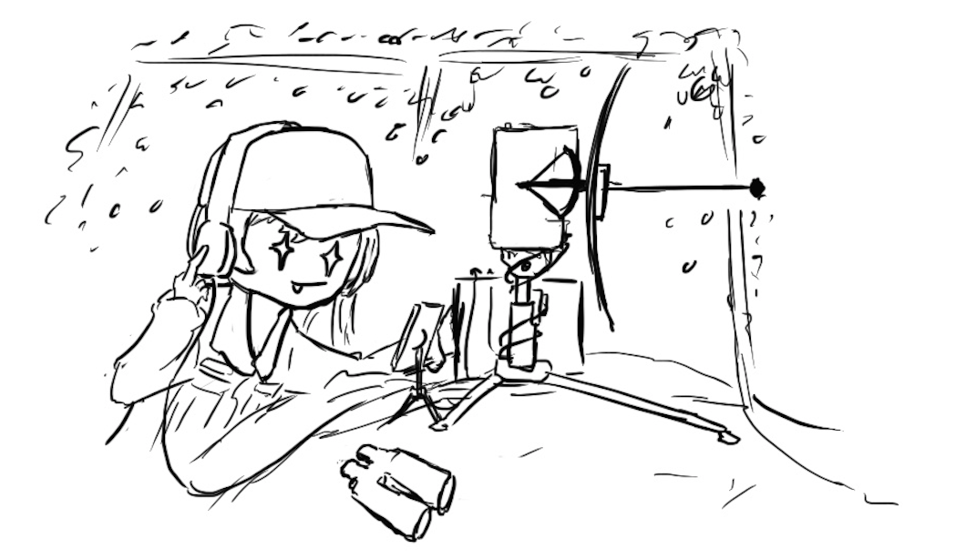
Traffic Analysis & Side Channels

Slide 31
Traffic Analysis & Side Channels
Traffic analysis: Analyzing who is talking to whom and when
The encryption schemes we’ll be studying do not hide the identity of who you’re t​​alking to
The information used for this analysis is often referred to as metadata: Data about the message and its context
Side channels: Information about the plaintext revealed as a result of the implementation of the scheme, not the scheme itself
Modern crypto systems are usually broken through side channels

Slide 32
Traffic Analysis & Side Channels in Practice: Spies
In the 1990s, there were some Russian spies in the US
The TV series “The Americans” was based on this incident
A Cuban number station had a bug: some nights it never broadcasted “9”
Normally, 0–9 would be equally frequent
It turns out this corresponded to when the Russian spies were on vacation
The way that random numbers were generated for cover traffic had a bug in it
The FBI used this as part of their investigation
Takeaway: Secure algorithms can be broken in insecure implementations, leaking information
Notes:
Revealed inadvertently by Struck and analyzed by Matt Blaze
TODO Nick

Slide 33

Nothing-Up-My-Sleeve-Numbers

Slide 34
Nothing-Up-My-Sleeve-Numbers
Cryptography uses a lot of constants
Initial state for SHA
Prime p and generator g in Diffie-Hellman
Parameters for elliptic-curve cryptography (curve equations, points on the curve like P and Q)
ipad and opad in HMAC
Usually, any value could work, but the designer needed to choose some constant for the algorithm
Example: In Diffie-Hellman, any large prime p and generator g works, but there’s a default p and g that everyone uses
Where do these default parameter values come from?

Slide 35
PRNG Sabotage: Dual_EC_DRBG
Dual_EC_DRBG: A PRNG published by the NSA behind the scenes
Relies on two public hard-coded parameters P and Q
P and Q are points on an elliptic curve
If P and Q are related by Q = eP (analogous to Q = P^{e} mod n in discrete log), you can learn the internal state!
It also sucked!
It was horribly slow (much slower than HMAC or CTR PRNGs)
It had subtle biases that shouldn’t exist in a secure PRNG: You could distinguish the upper bits from random
Cryptographers spotted these flaws early on
Why would anyone use such a horrible PRNG?

Slide 36
PRNG Sabotage: Dual_EC_DRBG
Why would anyone use such a horrible PRNG?
Story time:
RSA Data Security accepts $10 million from the NSA
In exchange, RSA Data Security implements Dual_EC in their RSA BSAFE library, and silently makes it the default PRNG
With RSA Data Security’s support, Dual_EC became a NIST standard
Used in other products
2013: Whistleblower Edward Snowden reveals classified NSA information
The New York Times vaguely mentions a crypto talk given by Microsoft people
Everybody quickly realized this referred to a backdoor the NSA inserted into Dual_EC
Backdoor: An attack inserted by an organization (e.g. NSA) so that they, but nobody else, can attack the system

Slide 37
PRNG Sabotage: Dual_EC_DRBG
With the backdoor, it’s possible to predict both future and past PRNG outputs
No rollback resistance, unlike HMAC-DRBG
Recall the attack when a PRNG is not rollback resistant:
Generate a secret key
Generate some other publicly visible random value (e.g. IVs, nonces, an NSA-sponsored “standard” that requires some random output)
Since the PRNG is not rollback-resistant, the NSA can view the public random value and use the backdoor to learn secret keys

Slide 38
PRNG Sabotage: Dual_EC_DRBG
Juniper Networks used Dual_EC in their virtual private networks (VPNs)
Juniper claims their version of Dual_EC was safe from the NSA backdoor
Juniper selected a different public parameter (Q) than the NSA’s public parameter
Later: Juniper is hacked
The hacker changed Dual_EC’s public parameter (Q) to give themselves a backdoor!
And now the original backdoor owner can’t get in…
Later: Juniper is hacked again
The hacker adds an SSH backdoor
Later: Juniper notices the SSH backdoor
… and also notices the changed Dual_EC backdoor
So they release an update to patch the Dual_EC backdoor
Later: Everyone receives an update
Everyone: “Ohh, patch for a backdoor. Let’s see what got fixed. Oh, these look like Dual_EC parameters…”
Notes:
Juniper: "But we did it safely, we used a different Q"
Sometime later, someone else notices: "Hmm, P and Q are the keys to the backdoor...let’s hack Juniper and re-key the lock!"
Whoever put in the first Dual_EC then went: "Oh crap, we got locked out but we can’t do anything about it!"
Sometime later, someone else goes: "Hey, let’s add an SSH backdoor"
Sometime later, Juniper goes: "Whoops, someone added an SSH backdoor. Let’s see what else got F’d with...oh, this number in the PRNG"
And then everyone else went: "Ohh, patch for a backdoor. Let’s see what got fixed. Oh, these look like Dual_EC parameters..."

Slide 39
Diffie-Hellman Sabotage?
Another case of potential sabotage
1024b Diffie-Hellman is moderately impractical
However, for a specially chosen p, cracking Diffie-Hellman becomes 1 million times easier
Recall: p is a public value. Most implementations use default hard-coded values of p
The most commonly-used “example” p has unknown origin! (lost to time)

Slide 40
Something Up Their Sleeves… (Maybe)
Mysterious public parameters can cast doubt even when a design is solid
Recall DES (the block cipher used before AES)
The DES standard was developed by IBM but with input from the NSA
Everyone was suspicious that the NSA tampered with S-boxes (hard-coded constant values in the block cipher algorithm)
It turns out they did: The NSA made them stronger against an attack that they knew about but the public didn’t know about
P-256 and P-384: Two elliptic curves defined by the NSA
Remember: Elliptic curves are public parameters in elliptic-curve cryptography
The elliptic curves were chosen mysteriously and cast doubt on whether there is a backdoor
Notes:
"I trust them because they are in CNSA, so the NSA uses them for top-secret communication: A backdoor here would be absolutely unacceptable...but only because I actually believe the NSA wouldn’t try to sabotage itself!" ~Nick Weaver

Slide 41
Takeaway: Nothing-Up-My-Sleeve-Numbers
Good systems should clearly and transparently describe how public parameters are generated
Argue about why these values provide good security (e.g. AES designers argued this for the values in their S-boxes)
Choose values with obvious human significance: The developer probably doesn’t have millions of values of obvious significance to brute-force and pick a value with a backdoor
Seed a PRNG with your name
The first few digits of π
0x67452301, 0xefcdab89, … (SHA-1)
Fractional parts of the square/cube roots of prime numbers (SHA-2)

Slide 42
Case Study: iPhone Security

Slide 43
iPhone Security
Apple’s security philosophy:
In your hands, you can access everything on your phone
In anybody else’s hands, the phone is an inert “brick” (nothing can be accessed)
Apple uses a small co-processor in the phone to handle all cryptography
The “Secure Enclave” (recall: small TCB)
The rest of the phone is untrusted
Memory is untrusted, so all data must be encrypted
The CPU must ask the Secure Enclave to decrypt data
Some data (e.g. credit card information for Apple Pay) is only readable by the Secure Enclave
Effaceable Storage
Data is often stored in multiple places for redundancy, or not entirely wiped on deletion (for speed)
Effaceable storage: A section of memory where if memory is wiped, it is guaranteed to be gone
Requires some electrical engineering trickery to implement

Slide 44
iPhone Security
A lot of keys encrypted by keys
There is a random master key, Kphone, that can be used to decrypt all the other keys
Kphone is encrypted by the user's password and stored in flash memory
Run PBKDF on the password to get Kuser, and use Kuser to encrypt Kphone
How do we prevent an offline brute-force attack?
Include a random 256-bit secret hardcoded into the Secure Enclave for encryption
The only way to get this secret is to take apart the chip!
The Secure Enclave can’t read the secret, but can only use it as an input for hardware cryptography
The user key Kuser is actually function of the password and Enc(secret, password)
Offline attacks are not possible without the secret
Takeaway: Mixing in on-chip secret requires online attacks!
If the attacker doesn't know the on-chip secret, they can’t perform an offline attack

Slide 45
iPhone Security
How do we prevent online brute-force attacks?
Online attacks must go through the secure enclave
Timeouts: After 5 tries, add a delay to slow down each try
After 10 tries, optionally wipe Kphone forever
Remember: Kphone is the root key for decrypting everything else. Erasing Kphone effectively erases everything on the phone!
Even if an attacker compromises the secure enclave, guessing is still limited to 10 tries per second
Takeaway: Timeouts and slow algorithms prevent online attacks. If possible, limit attackers to online attacks

Slide 46
iPhone Security: Backups
A necessary weakness: Backups
Backup: Copying all data from the phone somewhere else
The data is copied unencrypted (decrypted with the secret on the chip)
Backups are necessary so you can recover your data on another phone
Attack: Use backups to steal your data
The attacker finds a way to unlock your phone without your password (e.g. hold it to your face or use your fingerprint)
Remember: consider human factors!
The attacker syncs your phone with a new computer
Change of policy as of iOS 11
To create a backup on a new computer, you need to enter your password to trust the computer
Previous attack is no longer possible: can't create a backup without knowing the password

Slide 47
Case Study: Samsung
Samsung has a similar concept
But their implementation has, umm, issues…
Guess with, GCM with IV reuse!
And although “fixed”, you could do a downgrade attack to cause the fixed version to still reuse IVs
Takeaway: CTR mode is dangerous when used improperly…and even experts misuse it!
Cryptology ePrint Archive: Report 2022/208 Link
Alon Shakevsky and Eyal Ronen and Avishai Wool | February 20, 2022
In this work, we expose the cryptographic design and implementation of Android's Hardware-Backed Keystore in Samsung's Galaxy S8, S9, S10, S20, and S21 flagship devices. We reversed-engineered and provide a detailed description of the cryptographic design and code structure, and we unveil severe design flaws. We present an IV reuse attack on AES-GCM that allows an attacker to extract hardware-protected key material, and a downgrade attack that makes even the latest Samsung devices vulnerable to the IV reuse attack. We demonstrate working key extraction attacks on the latest devices. We also show the implications of our attacks on two higher-level cryptographic protocols between the TrustZone and a remote server: we demonstrate a working FIDO2 WebAuthn login bypass and a compromise of Google’s Secure Key Import.
Notes:
https://eprint.iacr.org/2022/208

Slide 48
Case Study: Snake Oil Cryptography

Slide 49
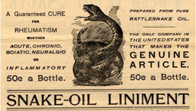
Snake Oil
Original meaning: Fraudulent “cure-all” medicines sold in the 1700s and 1800s
Sellers promised buyers that snake oil cures all diseases (even though it doesn’t)
Took advantage of uninformed buyers and lack of regulations
Modern meaning: Scams
Using deceptive advertising to trick uninformed buyers into buying useless products
Snake oil security (snake oil cryptography): Useless security products advertised to uninformed buyers

Slide 50
Signs of Snake Oil Cryptography
Amazingly long key lengths
Once brute-forcing a key becomes astronomically hard, making it longer probably doesn't provide extra security
The NSA is super paranoid, and even they don’t use >256-bit symmetric keys or >4,096-bit public keys
New algorithms and wild protocols
There is no reason to use a brand-new block cipher, hash algorithm, public-key algorithm, etc.
Existing protocols have been vetted by security experts for years: They’re widespread for a good reason!
New protocols probably means someone is trying to write their own crypto (and asking for trouble!)
Fancy-sounding technical buzzwords
Claims of inventing “new math”

Slide 51
Signs of Snake Oil Cryptography
“One time pads”
Recall: One-time pads are secure if you never reuse the key
Recall: Secure one-time pads are highly impractical
Almost all schemes advertised as “one-time pads” probably aren't true one-time pads
Wacky stream ciphers (often self-designed) are often advertised as “one-time pads”
Rigged “cracking contests”
Advertising a secure scheme by challenging the public to break the scheme
The challenge is often “decrypt this message” with no context or structure
Example: Telegram offered a $300,000 prize in a contest to break their encryption
Notes:
Telegram quotes
"It's like someone who had never seen cake but heard it described tried to bake one. With thumbtacks and iron filings." ~Matthew D. Green
"Exactly! GLaDOS-cake encryption. Odd ingredients; strange recipe; probably not tasty; may explode oven. :)" ~Alyssa Rowan

Slide 52

Snake Oil Example: Crown-Sterling
 | Link
Alleged “snake oil” crypto company sues over boos at Black Hat
Sean Gallagher | August 23, 2019
Crown Sterling seeks damages after attendee disrupts "controversial" talk on prime prediction.
Crown Sterling: A snake-oil cryptography company Black Hat: A security research conference
Notes:
https://arstechnica.com/information-technology/2019/08/company-accused-of-crypto-snake-oil-sues-black-hat-anonymous-detractors/

Slide 53
Snake Oil Example: Crown-Sterling
 | Link
Alleged “snake oil” crypto company sues over boos at Black Hat
Sean Gallagher | August 23, 2019
Grant's presentation, entitled "Discovery of Quasi-Prime Numbers: What Does this Mean for Encryption," was based on a paper called "Accurate and Infinite Prime Prediction from a Novel Quasi-PrimeAnalytical Methodology." That work was published in March of 2019 through Cornell University's arXiv.org by Grant's co-author Talal Ghannam—a physicist who has self-published a book called The Mystery of Numbers: Revealed through their Digital Root as well as a comic book called The Chronicles of Maroof the Knight: The Byzantine. The paper, a slim five pages, focuses on the use of digital root analysis (a type of calculation that has been used in occult numerology) to rapidly identify prime numbers and a sort of multiplication table for factoring primes.
Takeaway: Buzzwords are signs of snake oil cryptography
Notes:
https://arstechnica.com/information-technology/2019/08/company-accused-of-crypto-snake-oil-sues-black-hat-anonymous-detractors/

Slide 54
Snake Oil Example: Crown-Sterling
 | Link
Snake oil or genius? Crown Sterling tells its side of Black Hat controversy
Sean Gallagher | August 29, 2019
How does Time AI work? So how is Time AI said to work? Crown Sterling's website describes Time AI as "a dynamic non-factor based quantum encryption utilizing multidimensional encryption technology including time, music’s infinite variability, artificial intelligence, and most notably mathematical constants to generate entangled key pairs."
Takeaway: Brand-new math and buzzwords are signs of snake oil cryptography
Notes:
https://arstechnica.com/information-technology/2019/08/snake-oil-or-genius-crown-sterling-tells-its-side-of-black-hat-controversy/

Slide 55
Snake Oil Example: Crown-Sterling
 | Link
Medicine show: Crown Sterling demos 256-bit RSA key-cracking at private event
Sean Gallagher | September 20, 2019
Demo of crypto-cracking algorithm fails to convince experts.
Takeaway: Flashy demonstrations are signs of snake oil cryptography
Notes:
They actually used an off-the-shelf tool instead of their own algorithm
https://arstechnica.com/information-technology/2019/09/medicine-show-crown-sterling-demos-256-bit-rsa-key-cracking-at-private-event/

Slide 56
Snake Oil Example: Crown-Sterling
 | Link
Medicine show: Crown Sterling demos 256-bit RSA key-cracking at private event
Sean Gallagher | September 20, 2019
Nicholas Weaver, lecturer at the University of California Berkeley's Department of Electrical Engineering and Computer Sciences, reacted to Grant's latest demonstration with this statement to Ars: It was previously an open question whether Mr Grant was a fraud or just delusional. His new press release now makes me certain he is a deliberate fraud. He received a lot of feedback from cryptographers, both polite and rude, so showing this level of continued ignorance is willful at this point. His video starts with the ridiculously false notion that factoring is all there is for public key. He then insists that breaking a 256 bit RSA key or even a 512b key is somehow revolutionary. It's not. Professor [Nadia] Heninger at UCSD, as part of her work on the FREAK attack, showed that factoring a 512 bit key is easily accomplished with less than $100 of computing time in 2015. His further suggesting that breaking 512-bit breaks RSA is also ridiculous on its face. Modern RSA is usually 2048 bits or higher, and there is a near-exponential increase in the difficulty of factoring with the number of bits. At this point I have to conclude he is an outright fraud, and the most likely explanation is he's looking to raise investment from ignorant accredited investors. And now I wonder how many other companies he's started are effectively fraudulent.
Notes:
https://arstechnica.com/information-technology/2019/09/medicine-show-crown-sterling-demos-256-bit-rsa-key-cracking-at-private-event/

Slide 57

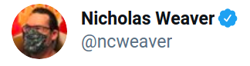
Snake Oil Example: Crown-Sterling
 | Link
 | September 21, 2019
FYI My offer stands you litigious fraudulent fuckwits. If you consider my statements that you are fraudulent fuckwits based on this release & demonstration libel, I'll gladly tell you a good address for service, just DM for info.
Notes:
https://twitter.com/ncweaver/status/1175518694534860800

Slide 58
Example: Cryptocurrency Snake Oil
IOTA: A cryptocurrency designed for the Internet of Things (IoT)
Uses a hash-based scheme instead of standard public key signatures, meaning you can never reuse a key
10,000-bit signatures (compare with 450-bit RSA signatures, which are considered big)
Created their own hash function… that was quickly broken
Claims to be a distributed system, but relies entirely on a central authority (not distributed)
Uses trinary math? (Requiring entirely new processors?)
Takeaway: Be able to recognize snake oil cryptography
Notes:
"aka IdiOTA" ~Nick

